Slide 1
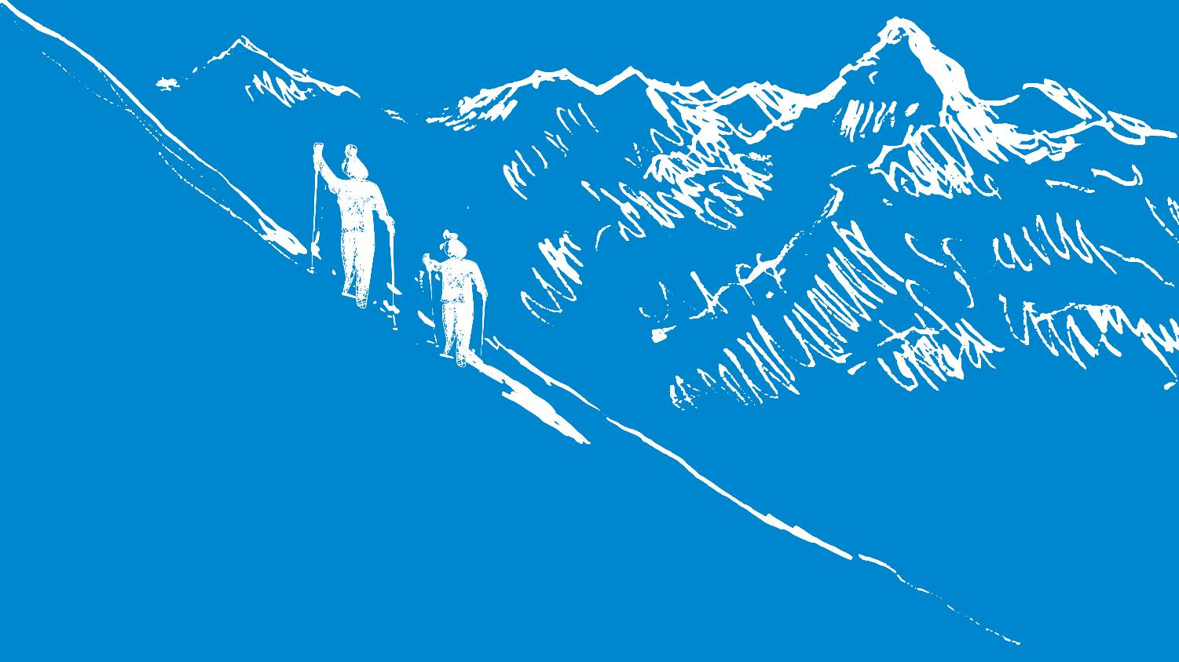
Das Projekt ALBINA
Euregio-Lawinenreport | Bollettino Valanghe dell’Euregio
03.01.2022
Trockenes Schneebrett - Update
Valanga a lastrone di neve asciutta - Update

Slide 2
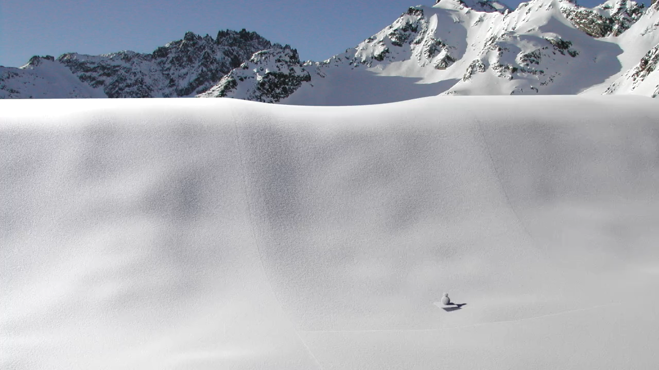
Gaume et al., (2018). Dynamic anticrack propagation in snow. Nature Communications. 9(1), 3047
Notes:
So in order to illustrate crack propagation in snow, I will show you the field test we perform to evaluate crack propagation propensity in situ. This is the so-called propagation saw test which consist in isolating a snow column

Slide 3
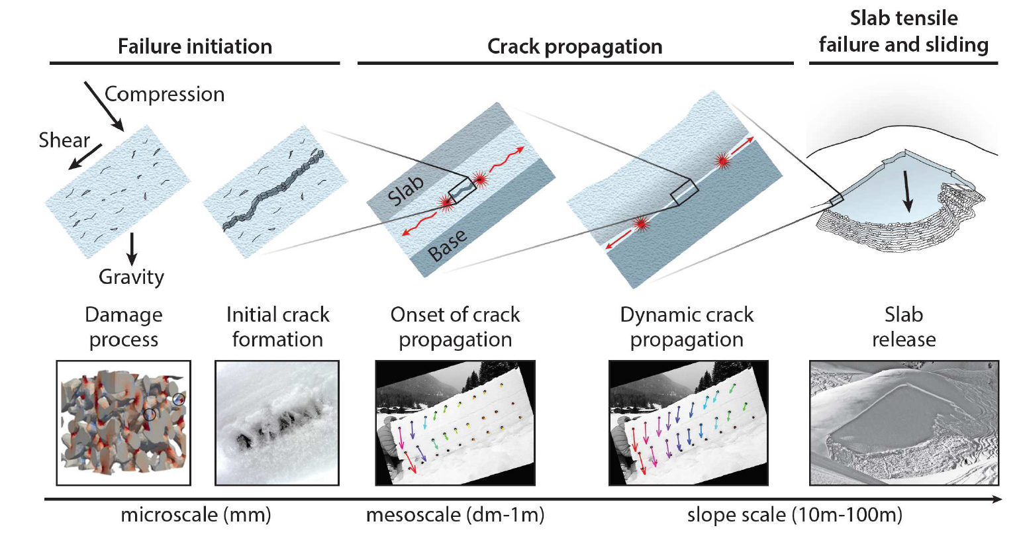
Auslösung von Schneebrettlawinen
Distacco valanghe a lastrone di neve asciutta
Adapted from Schweizer et al., (2016)

Slide 4
Auslösung von Schneebrettlawinen
Distacco valanghe a lastrone di neve asciutta
Adapted from Schweizer et al., (2016)

Slide 5
Auslösung von Schneebrettlawinen
Distacco valanghe a lastrone di neve asciutta
Adapted from Schweizer et al., (2016)

Slide 6
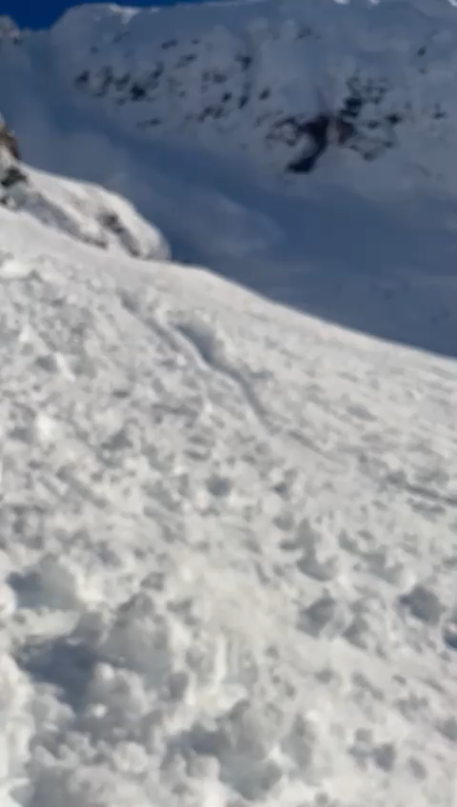

Slide 7
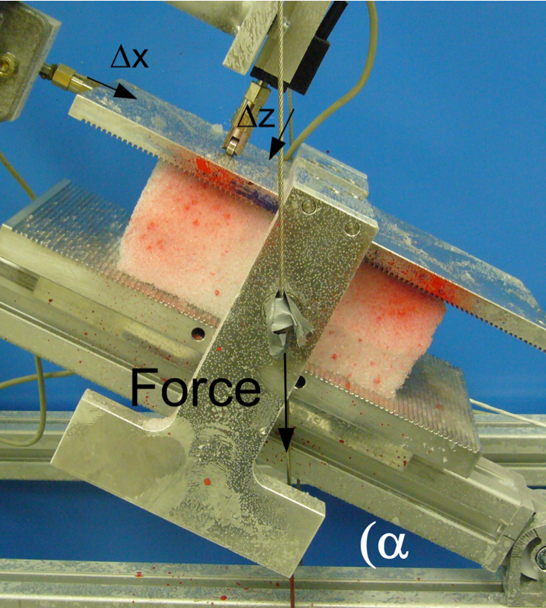
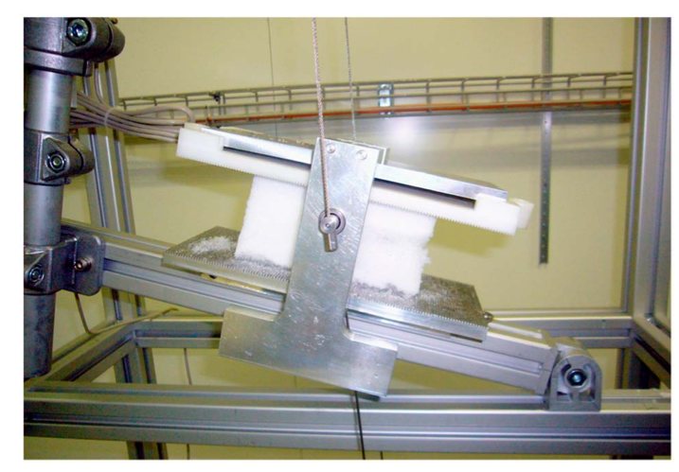
Labormessungen | Misure in laboratorio
Reiweger and Schweizer (2010, 2013)

Slide 8
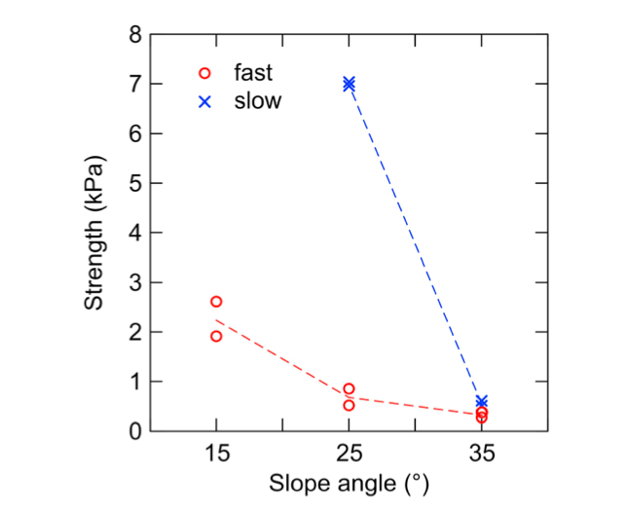
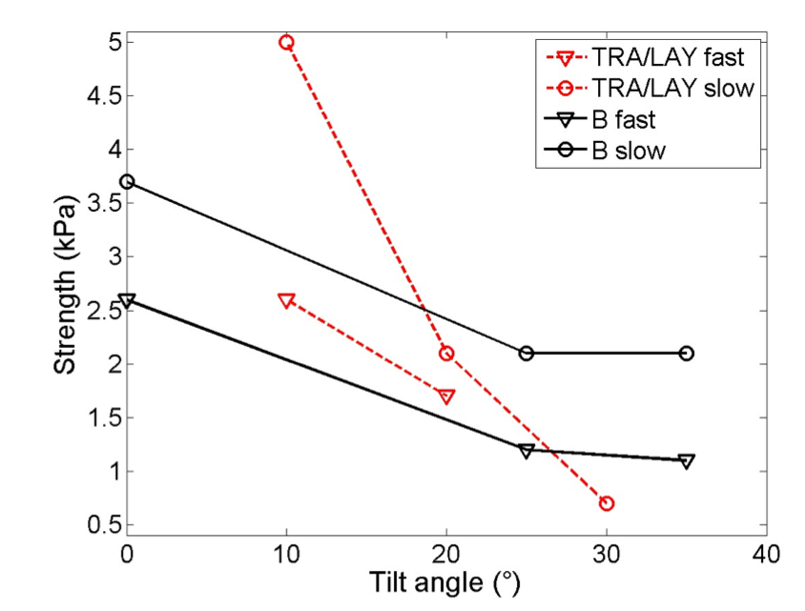
Ergebnisse | Risultati
d
----
g
----
d
d
----
e
----
d
d
----
f
----
Oh
Reiweger and Schweizer (2010, 2013)

Slide 9
Ergebnisse | Risultati
Persistente Schwach-schichten neigen eher zu Scherversagen als zu Kompressionsversagen
Steiles Gelände begünstigt den Schadensprozess, der zur Bildung eines Initialrisses führt
Die Festigkeit nimmt mit der Belastungsgeschwindigkeit ab
Strati deboli persistenti sono più suscettibili di rottura a taglio che di rottura a compressione
Terreno ripido favorisce il processo di danno che porta alla formazione di una prima rottura
La resistenza diminuisce con tasso di carico

Slide 10
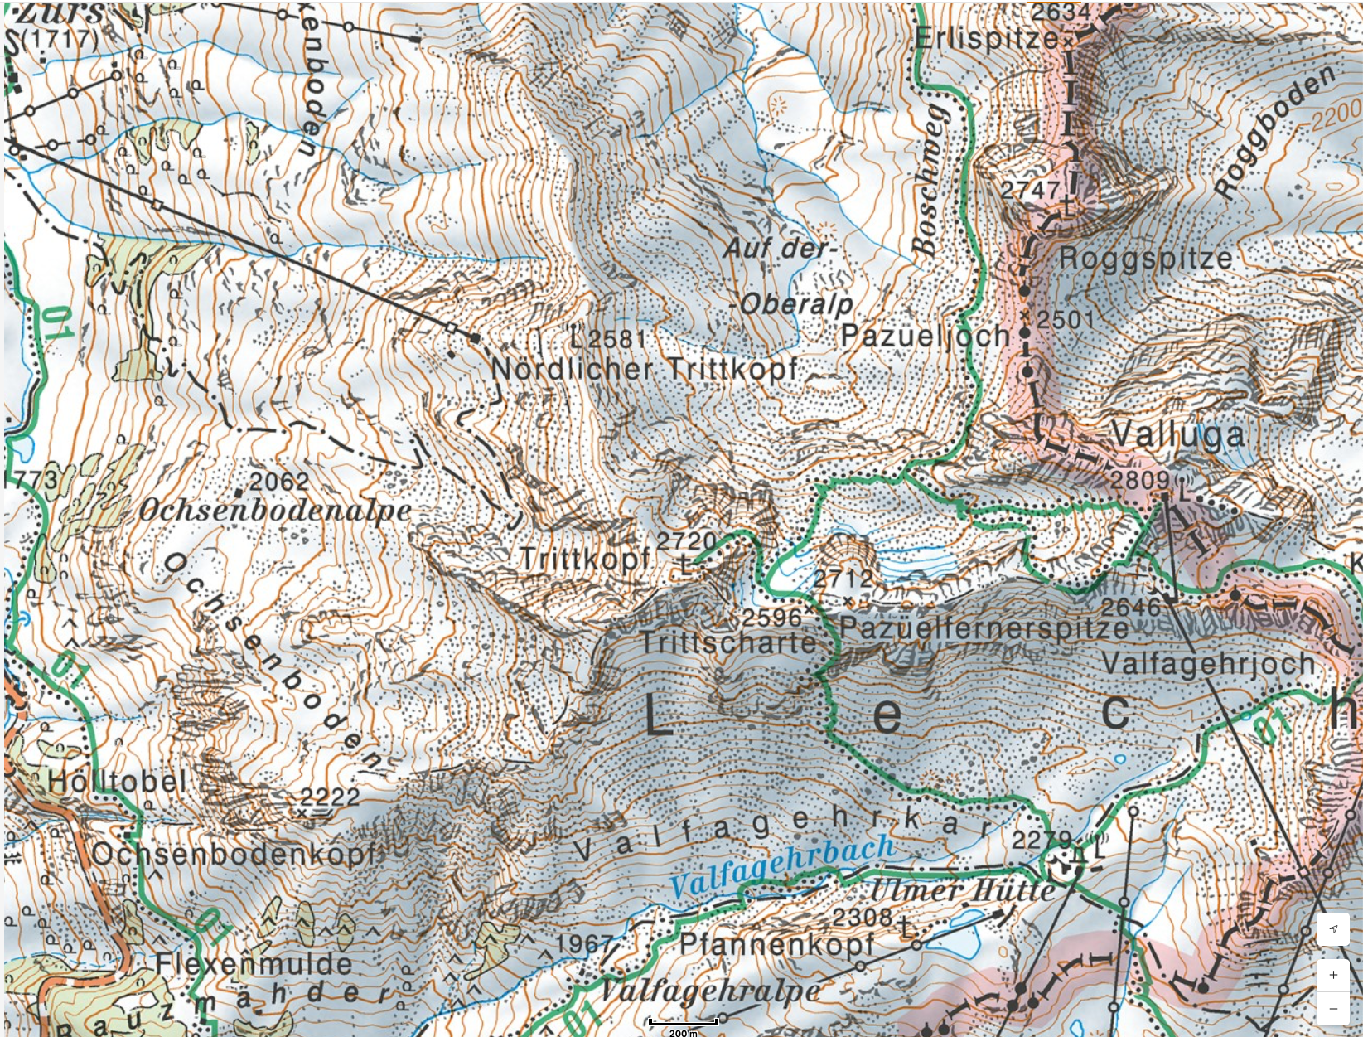

Slide 11
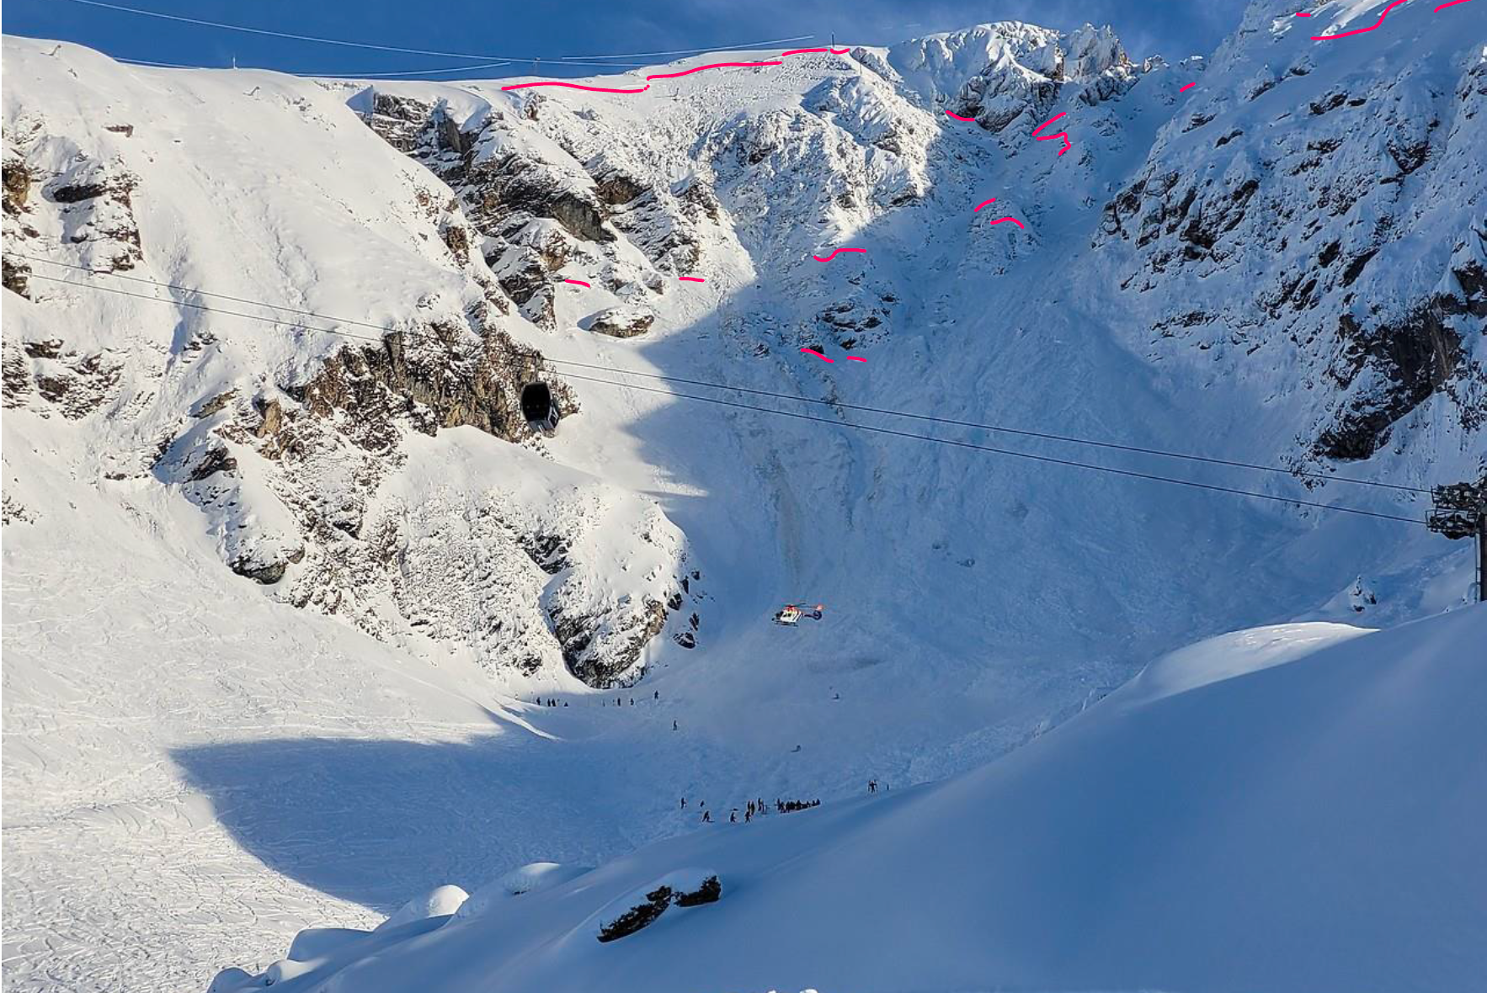

Slide 12
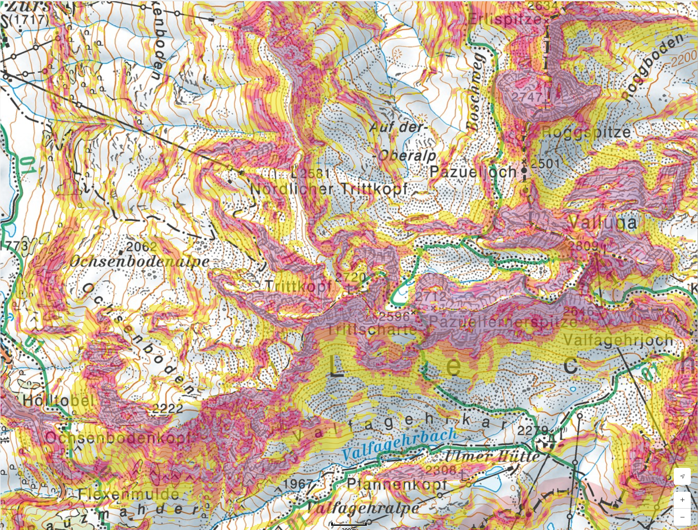

Slide 14
Auslösung von Schneebrettlawinen
Distacco valanghe a lastrone
Adapted from Schweizer et al., (2016)

Slide 15
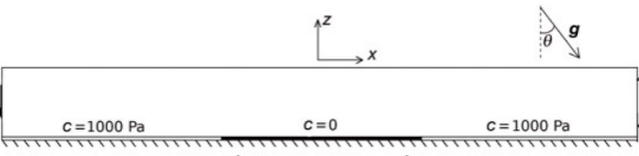
Die Herausforderung | La sfida
Shear-based models
McClung (1979); Chiaia et al. (2008); Gaume et al. (2013, 2014)
10
nicht realistisch
non reale
kritische Risslänge (m)
lunghezza critica della frattura (m)
0
0
20
40
60
Hangneigung | Pendenza

Slide 16
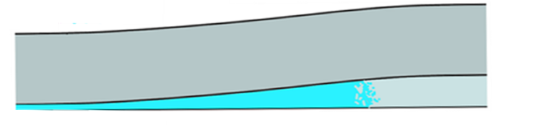
Die Herausforderung | La sfida
Shear-based models
Collapse-based or “anticrack” models
McClung (1979); Chiaia et al. (2008); Gaume et al. (2013, 2014)
Heierli et al. (2008, 2010)
nicht realistisch
non reale
10
nicht realistisch
non reale
0.5
kritische Risslänge (m)
lunghezza critica della frattura (m)
kritische Risslänge (m)
lunghezza critica della frattura (m)
0
0
0
20
40
60
0
20
40
60
Hangneigung | Pendenza
Hangneigung | Pendenza

Slide 17
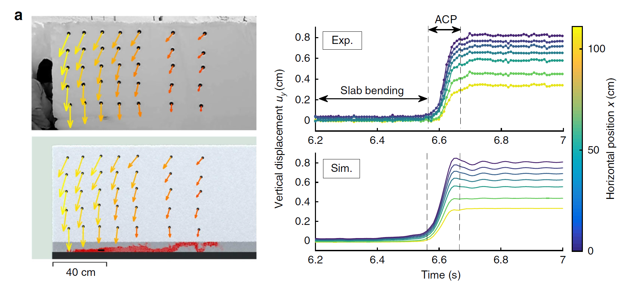
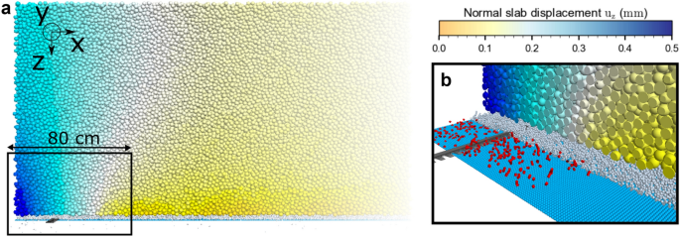
Die Herausforderung | La sfida
Shear-based models
FEM: Gaume et al. (2018)
Shear-based models
Collapse-based or “anticrack” models
McClung (1979); Chiaia et al. (2008); Gaume et al. (2013, 2014)
McClung (1979); Chiaia et al. (2008); Gaume et al. (2013, 2014)
Heierli et al. (2008, 2010)
MPM: Gaume et al. (2018)
nicht realistisch
non reale
10
10
nicht realistisch
non reale
0.5
not realistic
DEM: Bobillier et al. (2021)
kritische Risslänge (m)
lunghezza critica della frattura (m)
kritische Risslänge (m)
lunghezza critica della frattura (m)
critical crack length (m)
0
0
0
0
0
20
20
40
40
60
60
0
20
40
60
Hangneigung | Pendenza
slope angle
Hangneigung | Pendenza

Slide 18
Die Herausforderung | La sfida
Shear-based models
Collapse-based or “anticrack” models
McClung (1979); Chiaia et al. (2008); Gaume et al. (2013, 2014)
Heierli et al. (2008, 2010)
nicht realistisch
non reale
10
nicht realistisch
non reale
0.5
kritische Risslänge (m)
lunghezza critica della frattura (m)
kritische Risslänge (m)
lunghezza critica della frattura (m)
0
0
0
20
40
60
0
20
40
60
Hangneigung | Pendenza
Hangneigung | Pendenza

Slide 19

Die Herausforderung | La sfida

Slide 20
Anwendung der Modelle applicazione modelli

Slide 21
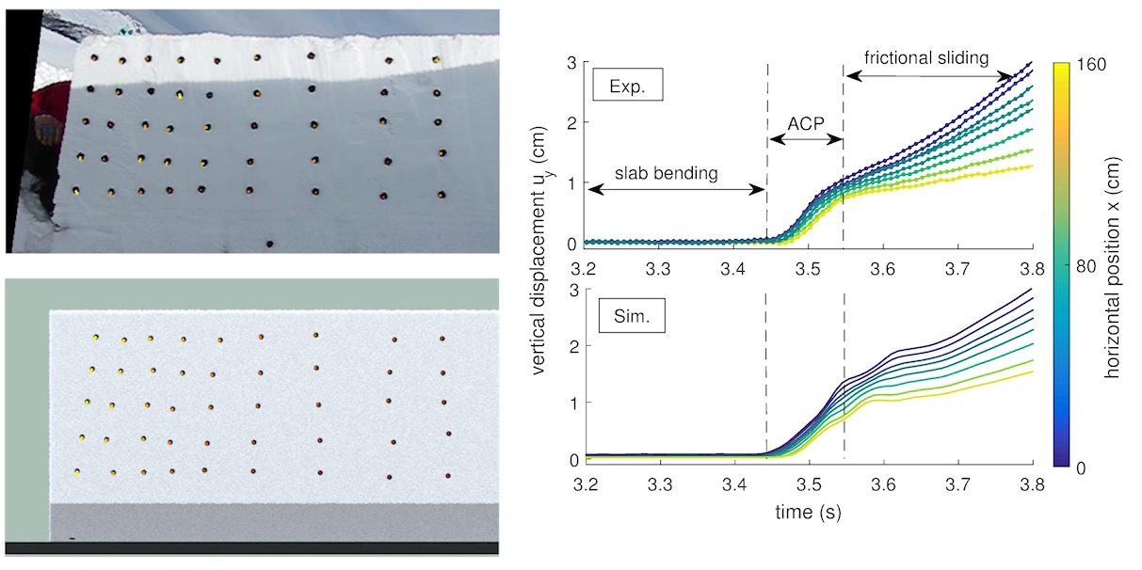
Anwendung der Modelle applicazione modelli

Slide 22
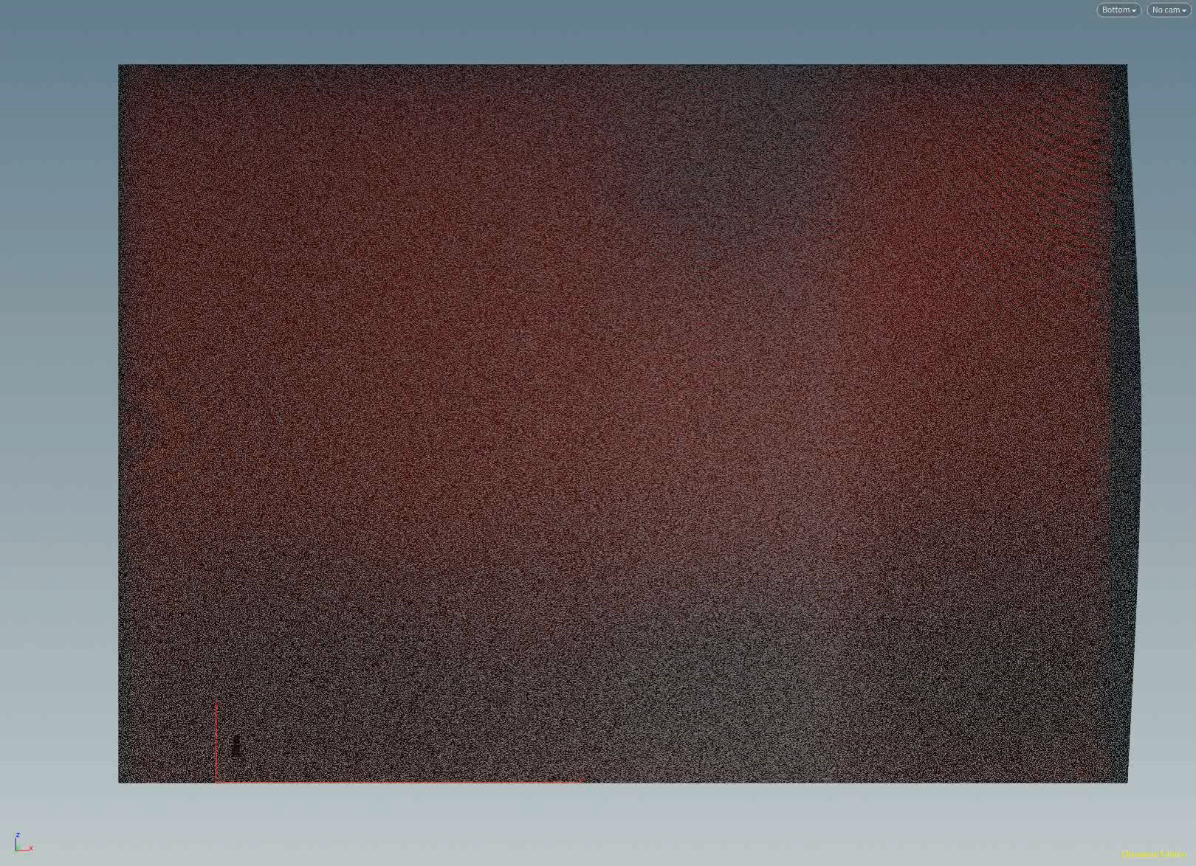

Hangaufwärts | Verso il pendio
Gaume et al., (2019). Investigating the release and flow of snow avalanches at the slope-scale using a unified model based on the material point method. CRST.168, 102647
Notes:
So in order to illustrate crack propagation in snow, I will show you the field test we perform to evaluate crack propagation propensity in situ. This is the so-called propagation saw test which consist in isolating a snow column

Slide 23
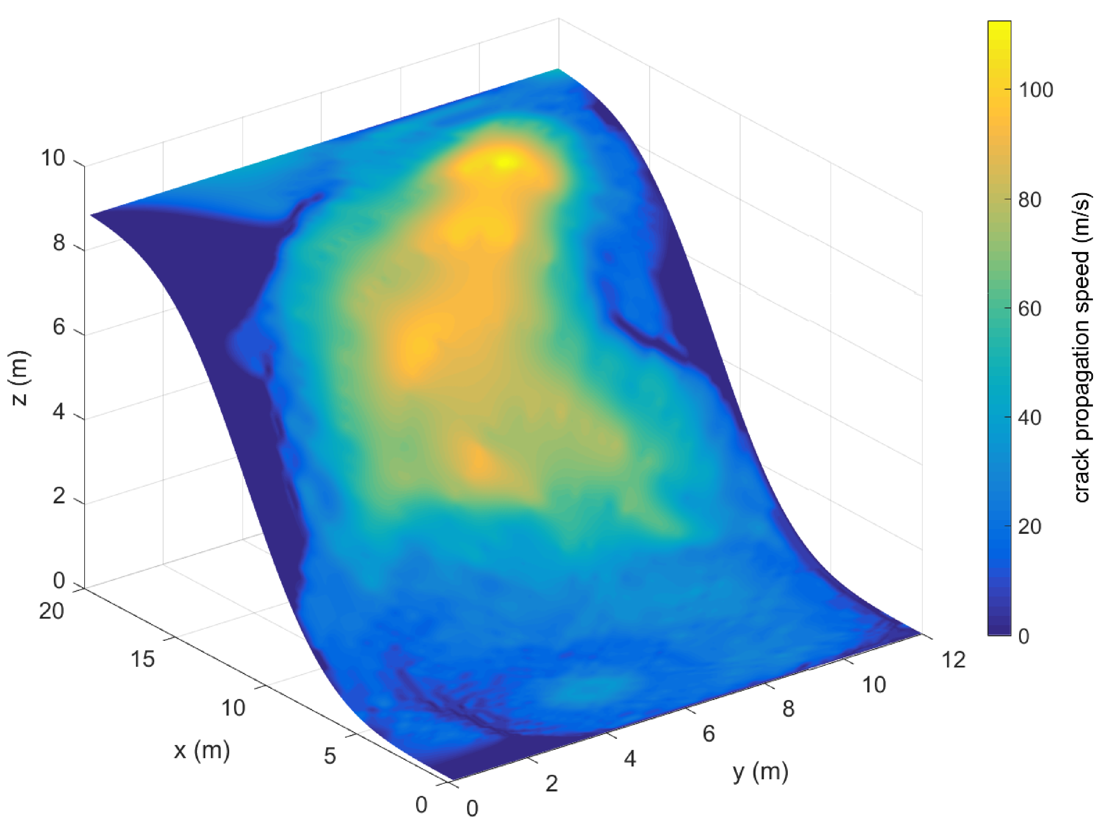
Gaume et al., (2019). Investigating the release and flow of snow avalanches at the slope-scale using a unified model based on the material point method. CRST.168, 102647
Notes:
So in order to illustrate crack propagation in snow, I will show you the field test we perform to evaluate crack propagation propensity in situ. This is the so-called propagation saw test which consist in isolating a snow column

Slide 24
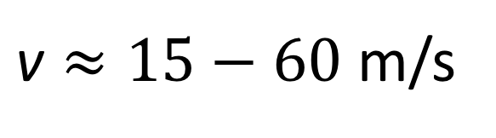
Geschwindigkeit der Bruchfortpflanzung Velocità di propagazione
$\text{v}≈15−60$ m/s
van Herwijnen et al. (2005)
Gaume et al. (2018)

Slide 25
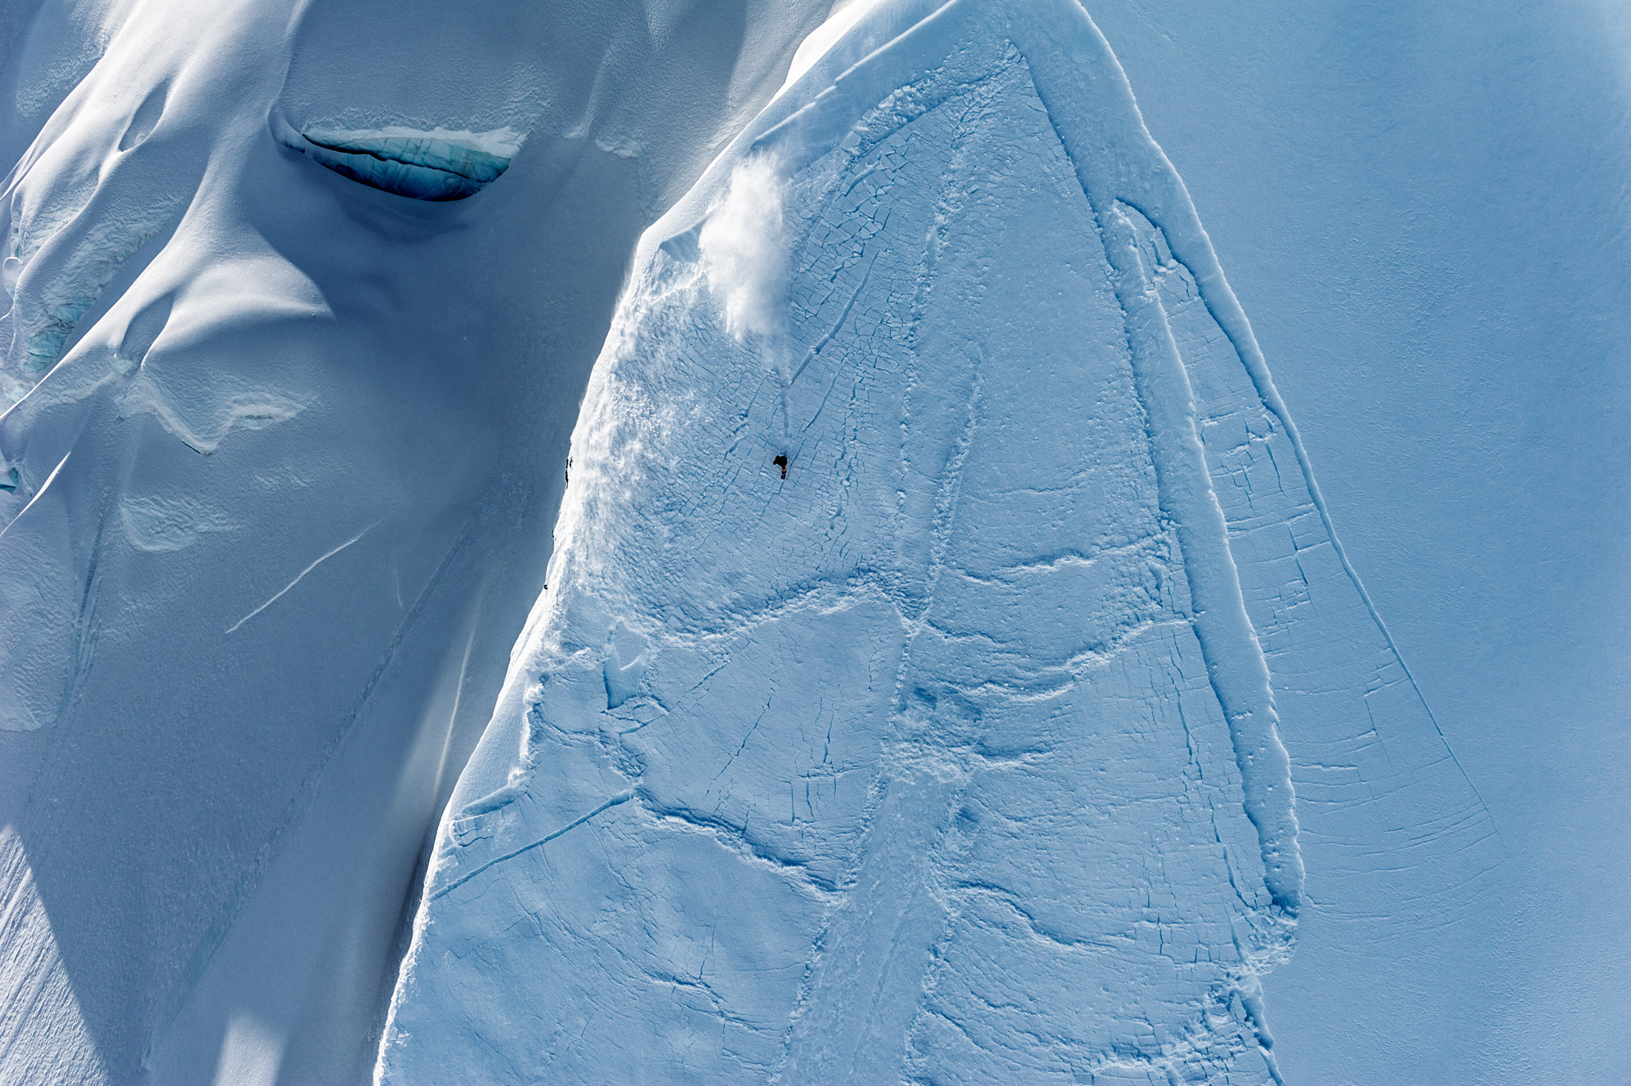
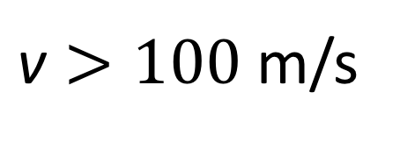
Geschwindigkeit der Bruchfortpflanzung Velocità di propagazione
$\text{v}≈15−60$ m/s
$\text{v}>100$m/s
van Herwijnen et al. (2005)
Gaume et al. (2018)
Hamre et al. (2014)

Slide 26
Gaume et al., (2019). Investigating the release and flow of snow avalanches at the slope-scale using a unified model based on the material point method. CRST.168, 102647
Notes:
So in order to illustrate crack propagation in snow, I will show you the field test we perform to evaluate crack propagation propensity in situ. This is the so-called propagation saw test which consist in isolating a snow column

Slide 27
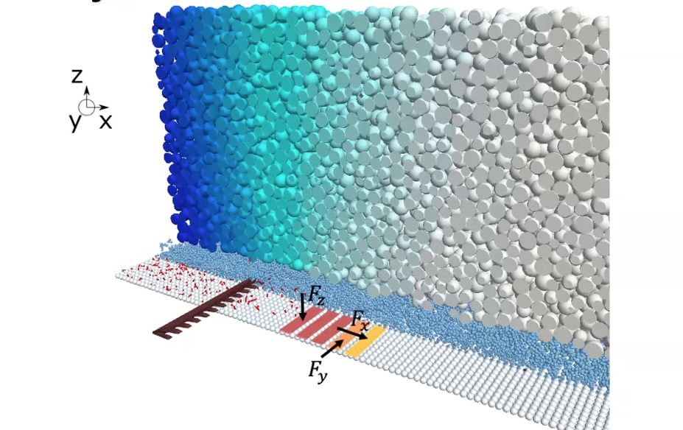
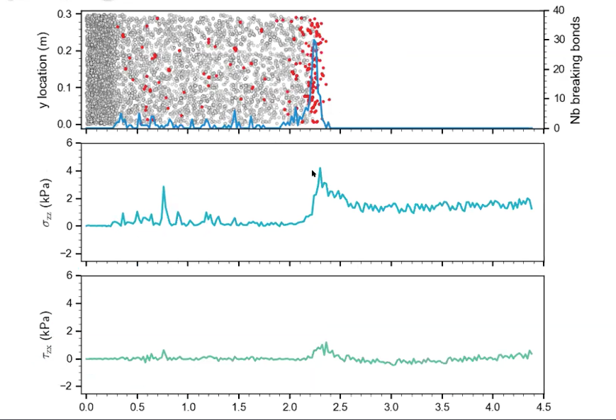
Geschwindigkeit der Bruchfortpflanzung Velocità di propagazione

Slide 28
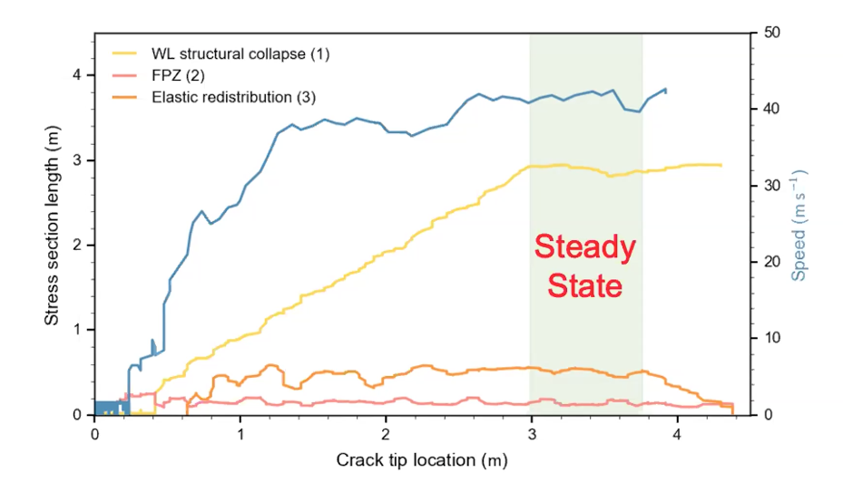
Geschwindigkeit der Bruchfortpflanzung Velocità di propagazione

Slide 29
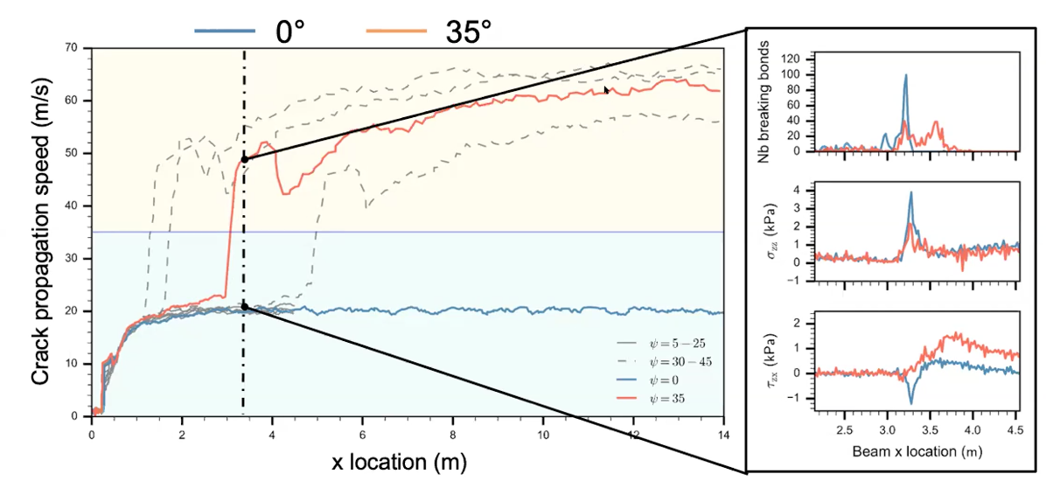
Geschwindigkeit der Bruchfortpflanzung Velocità di propagazione

Slide 30
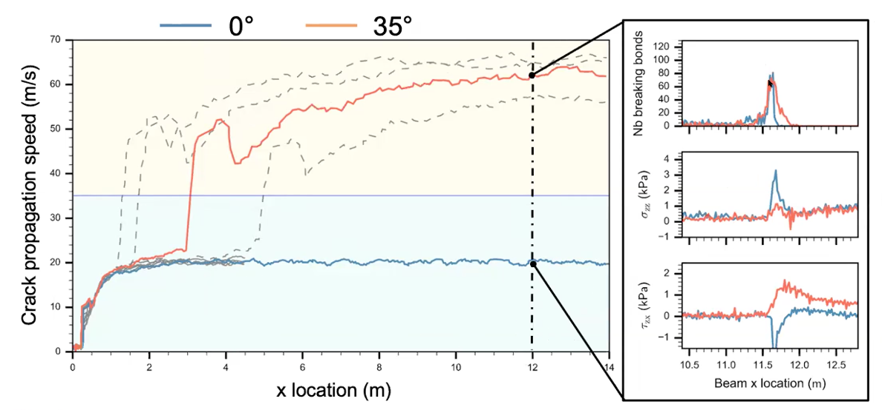
Geschwindigkeit der Bruchfortpflanzung Velocità di propagazione

Slide 31

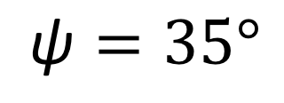
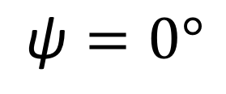
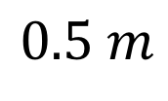
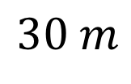
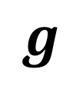
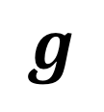
$$g$$
$$0.5 m$$
$$\text{ψ}=0°$$
$$30 m$$
$$g$$
$$\text{ψ}=35°$$

Slide 32
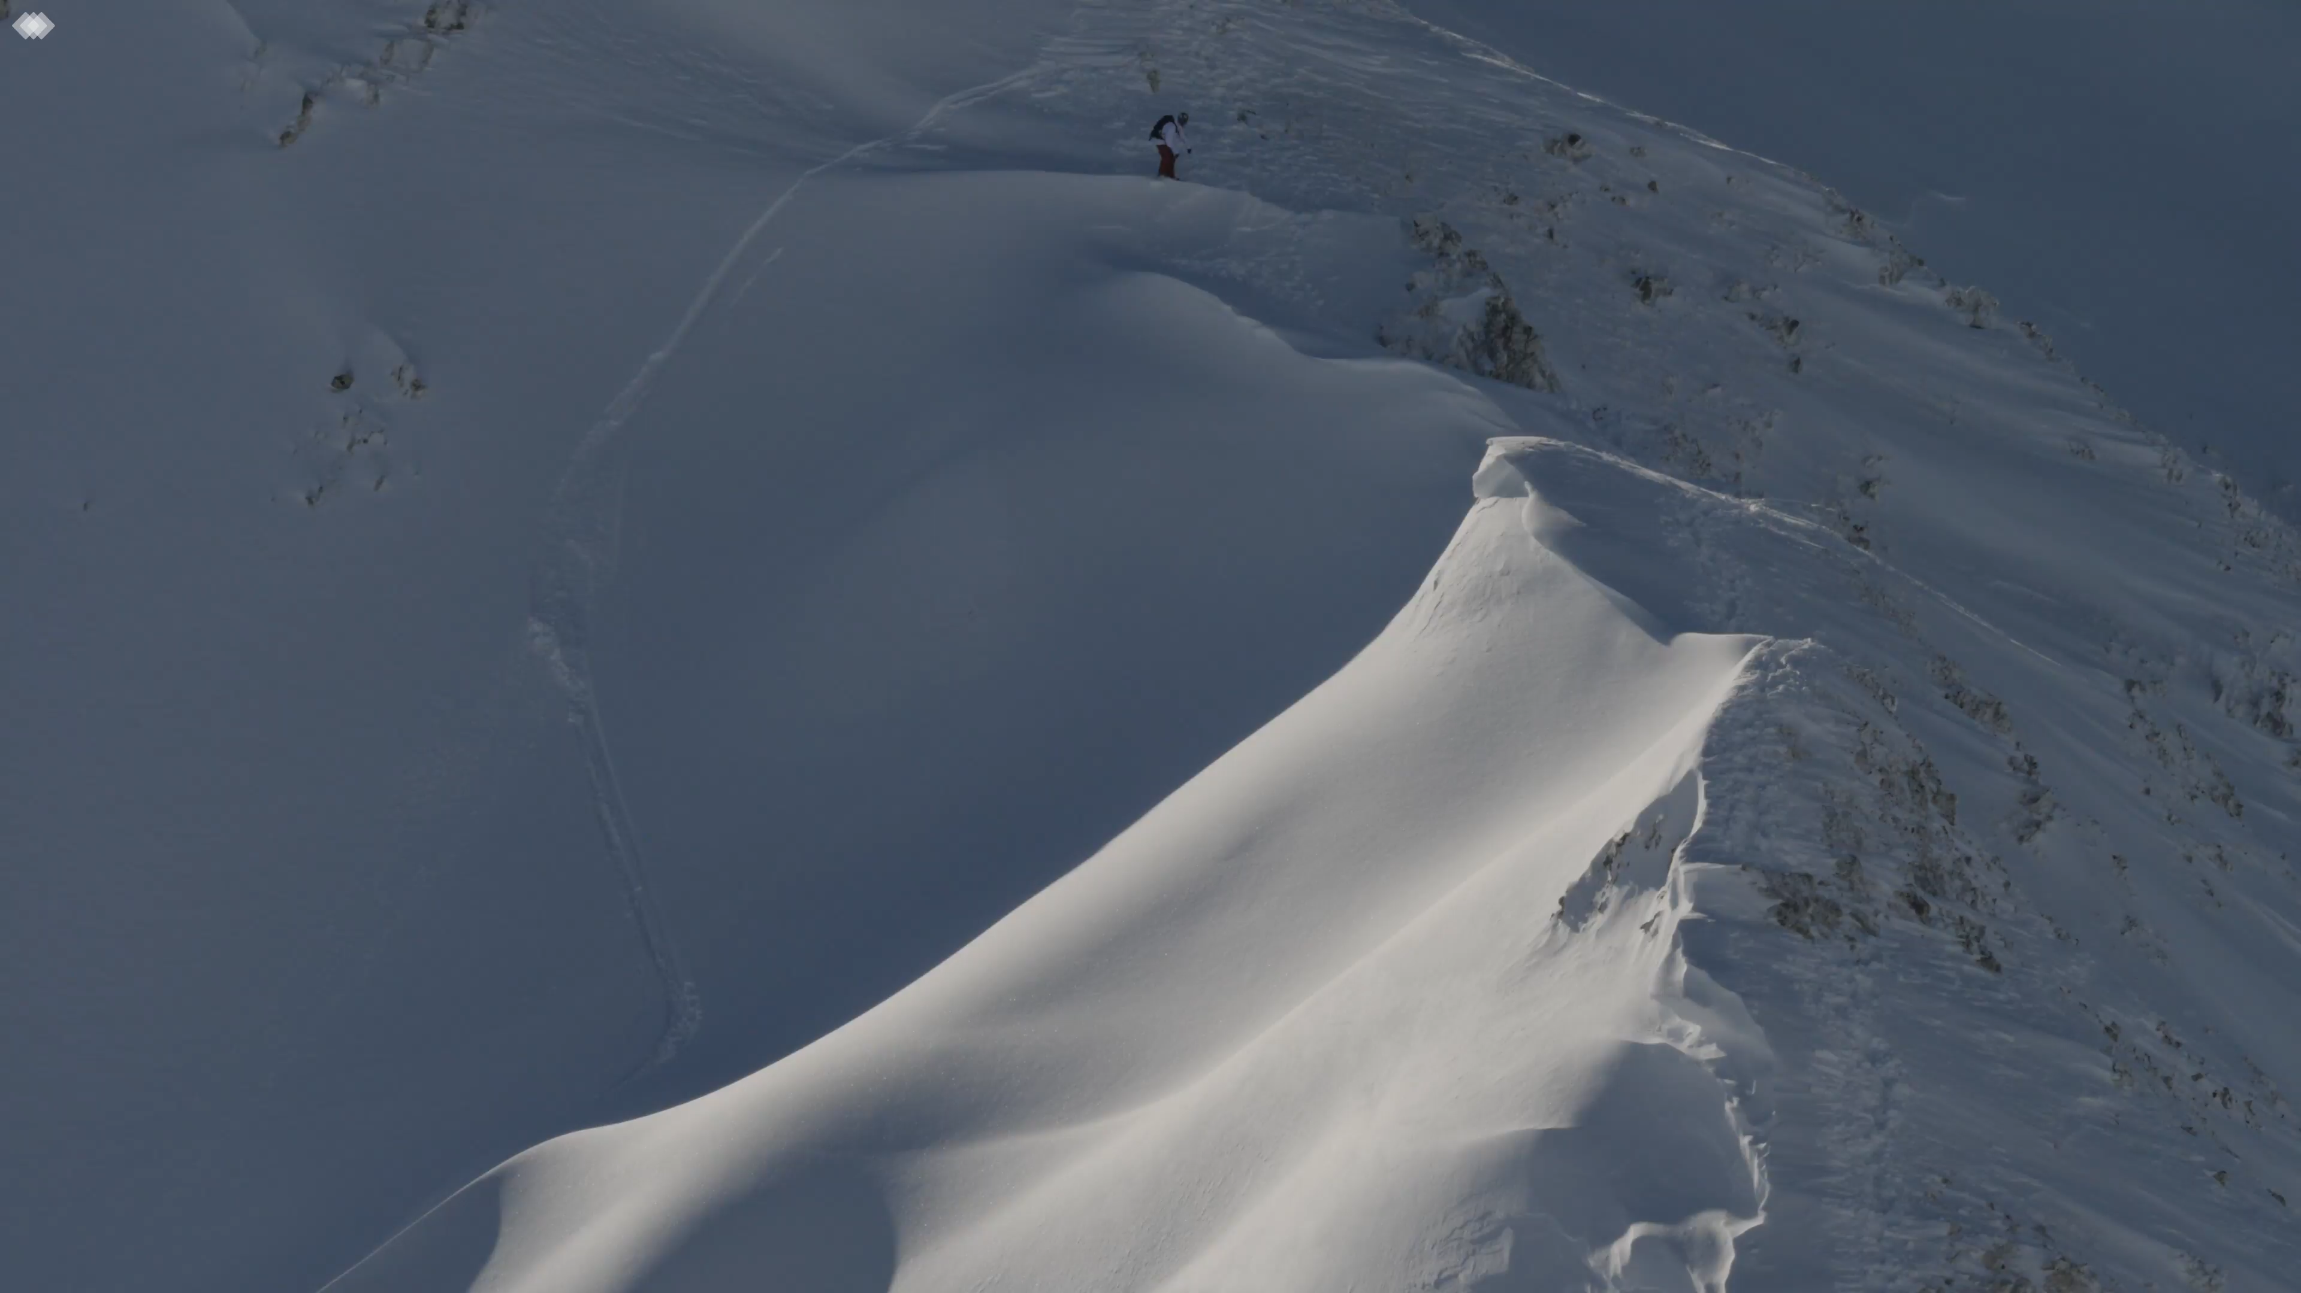
Notes:
So in order to illustrate crack propagation in snow, I will show you the field test we perform to evaluate crack propagation propensity in situ. This is the so-called propagation saw test which consist in isolating a snow column

Slide 33
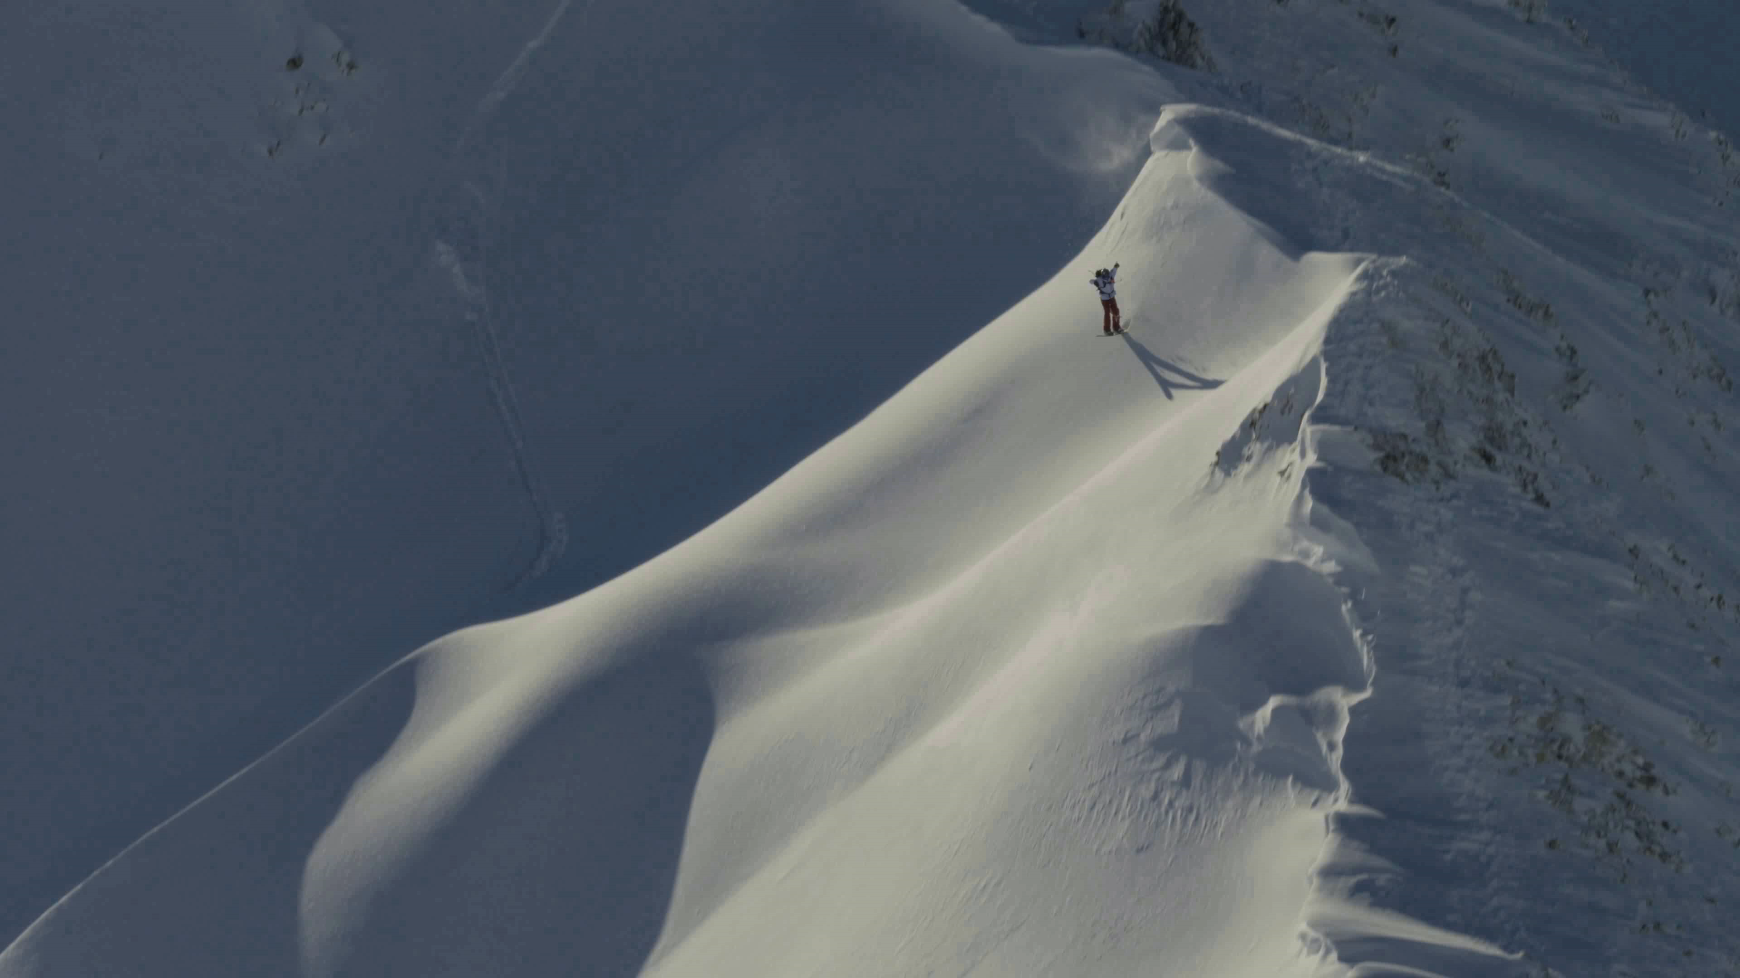
Notes:
So in order to illustrate crack propagation in snow, I will show you the field test we perform to evaluate crack propagation propensity in situ. This is the so-called propagation saw test which consist in isolating a snow column

Slide 34
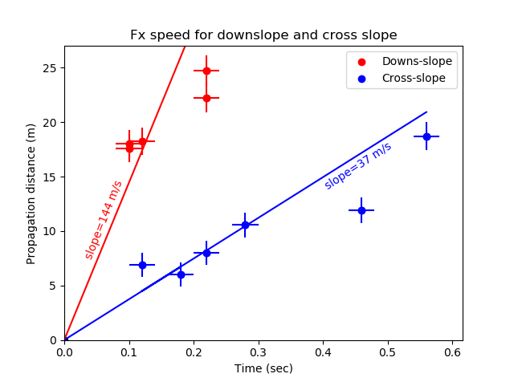
Notes:
So in order to illustrate crack propagation in snow, I will show you the field test we perform to evaluate crack propagation propensity in situ. This is the so-called propagation saw test which consist in isolating a snow column

Slide 35
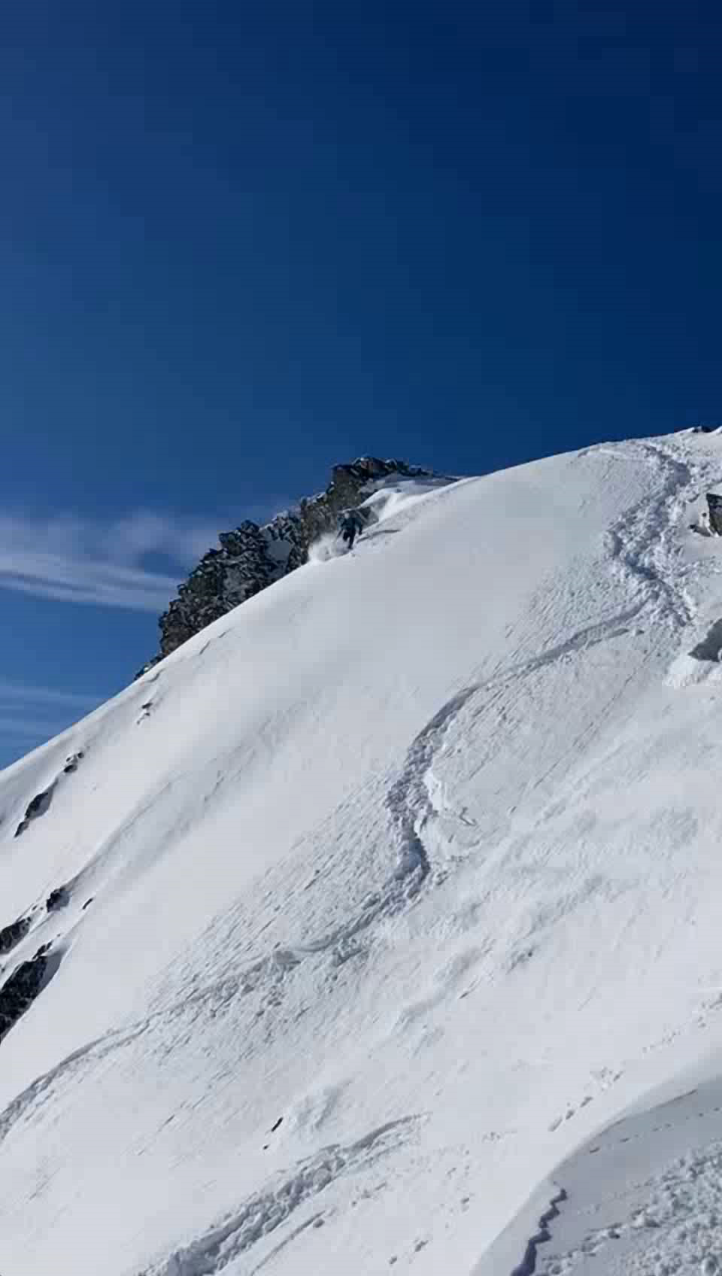
© Arriskeus
Notes:
So in order to illustrate crack propagation in snow, I will show you the field test we perform to evaluate crack propagation propensity in situ. This is the so-called propagation saw test which consist in isolating a snow column

Slide 36
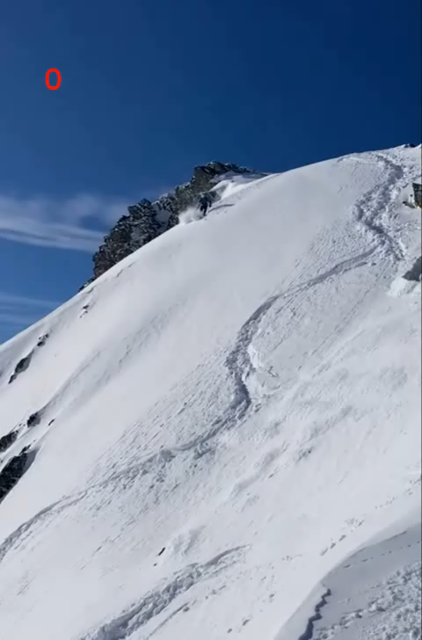
Notes:
So in order to illustrate crack propagation in snow, I will show you the field test we perform to evaluate crack propagation propensity in situ. This is the so-called propagation saw test which consist in isolating a snow column

Slide 37
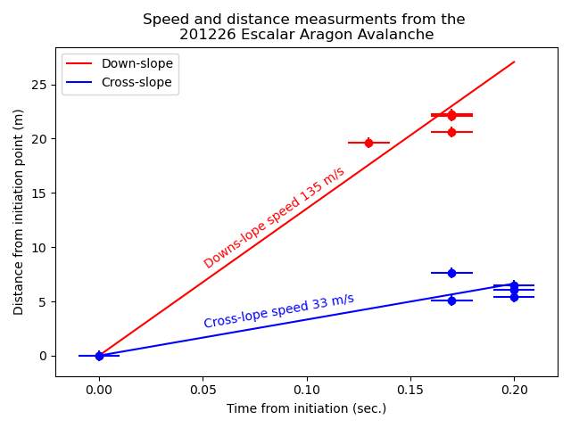
Notes:
So in order to illustrate crack propagation in snow, I will show you the field test we perform to evaluate crack propagation propensity in situ. This is the so-called propagation saw test which consist in isolating a snow column

Slide 38


Einfachere Modelle | modelli piu semplici
3D MPM
DA MPM

Slide 39

Einfachere Modelle | modelli piu semplici

Slide 40
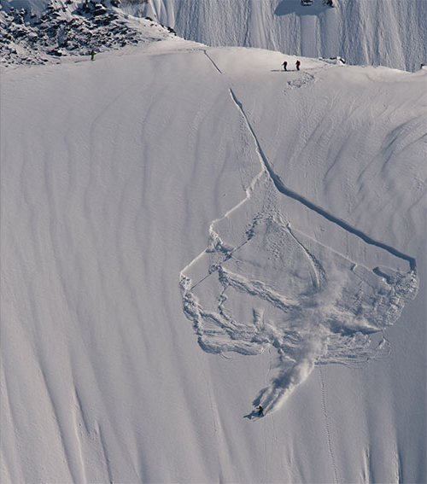
© Montagne magazine

Slide 41
© Montagne magazine

Slide 42
